Slide 1
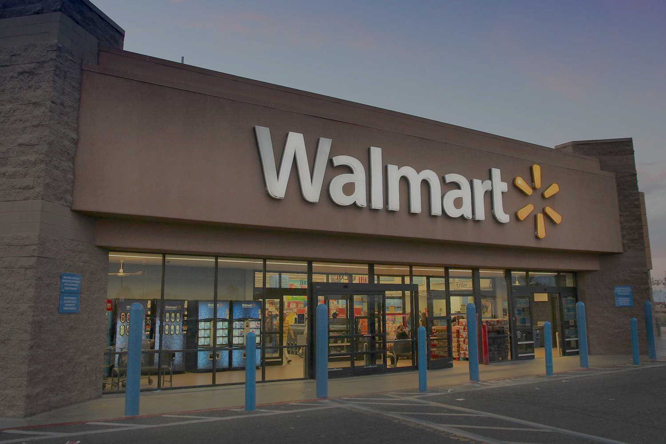
Walmart Sales & Customer Analysis Using SQL
Data-driven Insights into Retail Performance
Name : Debdatta Mukherjee
Date : October, 2025

Slide 2


Project Overview
Walmart is one of the world’s largest retail chains, and data plays a crucial role in understanding customer preferences, optimizing product categories, and improving profitability. This project uses transactional sales data from Walmart branches across multiple cities to extract actionable business insights using SQL.
Goal:
Analyze sales, profitability, customer satisfaction, and payment patterns to help Walmart improve operations and decision-making.

Slide 3
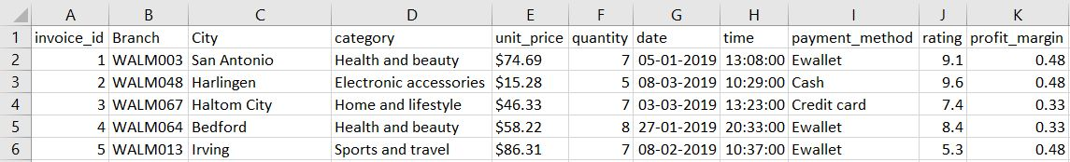
Dataset Description
Total records: 10020
Dataset downloaded from KAGGLE

Slide 4
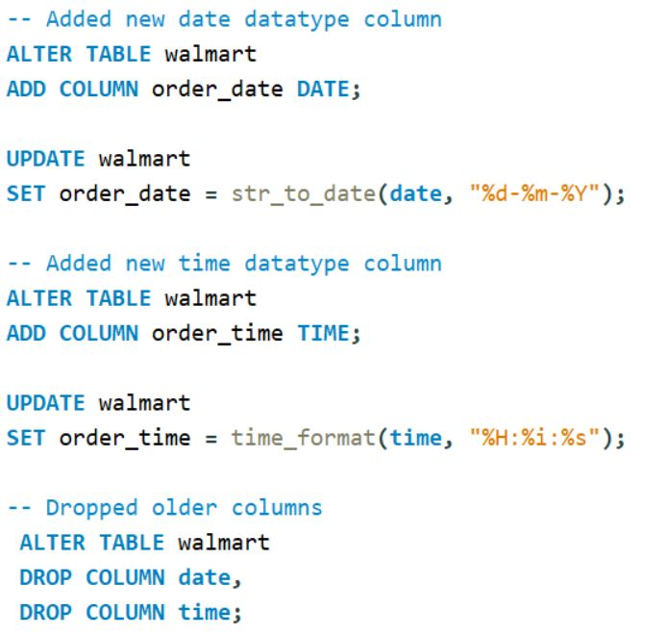
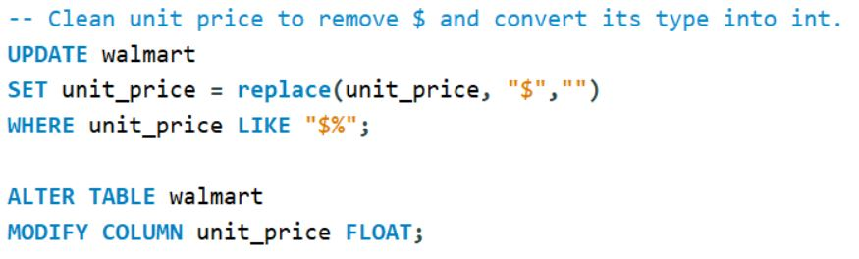
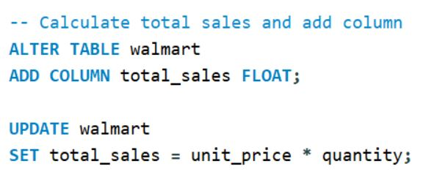
Data Preparation
3.
1.
2.

Slide 5
Business Objectives
Understand sales performance by branch, city, and category.
Identify time-based sales patterns (daily, monthly, hourly).
Evaluate payment preferences and profitability.
Analyze customer satisfaction trends and factors influencing ratings.
Provide data-driven recommendations for business optimization.

Slide 6
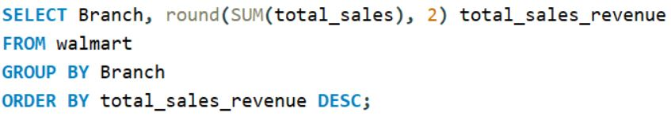
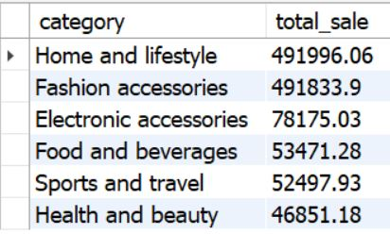
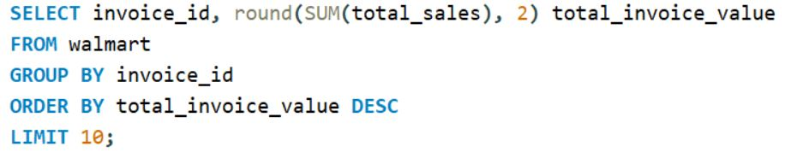
Sales Performance Analysis
1. What is the total sales revenue generated by each branch?
2.Which product category contributes the highest total sales?
3. What are the top 10 highest-value invoices (by total amount)?
4. Which city has the highest total revenue?
--Weslaco has the highest revenue of $46644.79
5. What is the average unit price and quantity sold per branch?

Slide 7
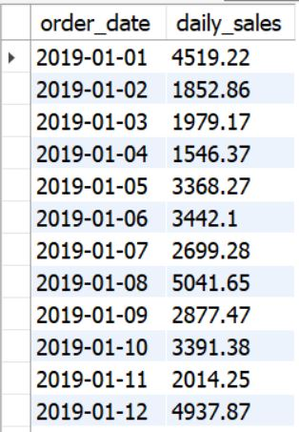
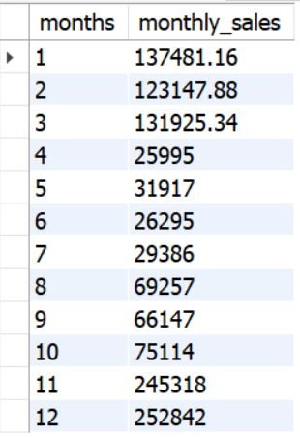
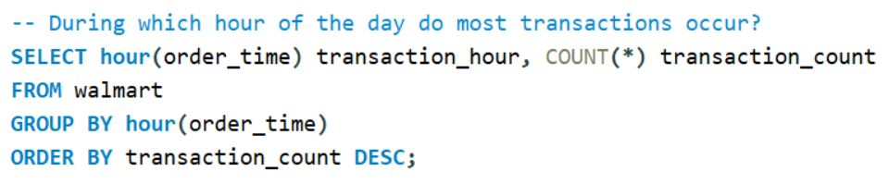
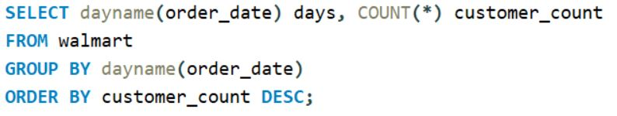
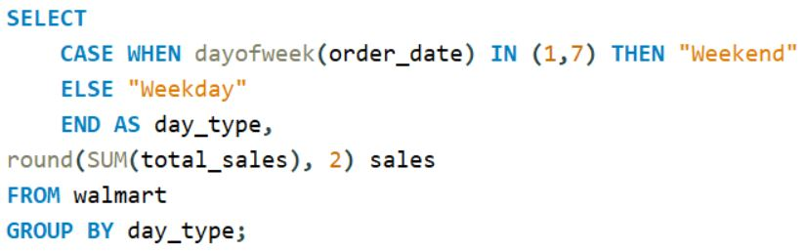
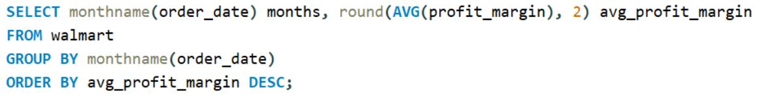
Time-based Analysis
1. What are the total daily and monthly sales trends?
3. During which hour of the day do most transactions occur?
4. During which hour of the day do most transactions occur?
5. During which hour of the day do most transactions occur?
2. What are the total daily and monthly sales trends?

Slide 8
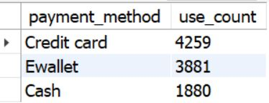
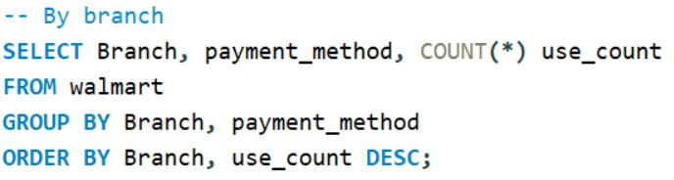
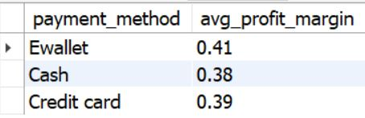
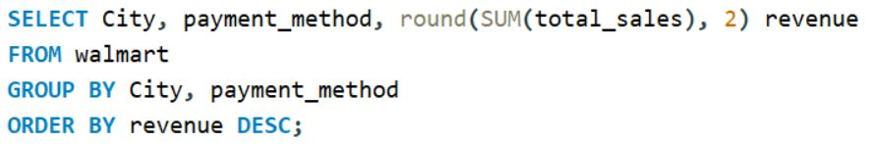
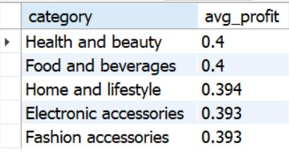
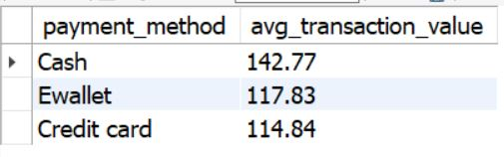
Payment and Profit Insights
1. Which payment method is used most frequently overall and by branch?
2. What is the average profit margin per payment method?
4. Which combination of city and payment method yields the most revenue?
3. Identify the top 5 most profitable product categories.
5. How does the average transaction value differ across payment methods?

Slide 9
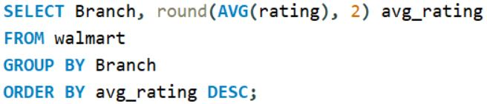
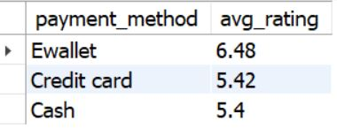

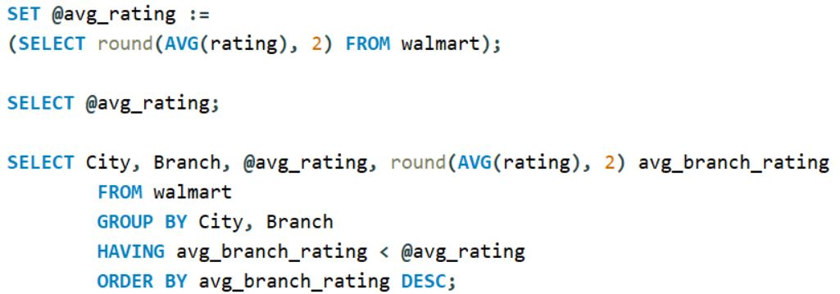
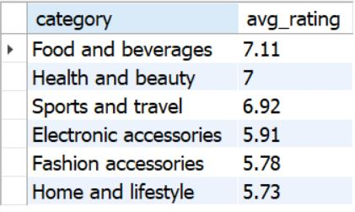
Customer and Rating Insights
1. What is the average rating for each branch?
4. How do ratings vary across different payment methods?
2. Do higher ratings correlate with higher profit margins?
5. Are there specific cities or branches where customer satisfaction is below average?
3. Which product categories receive the highest average ratings?

Slide 10
Key Performance Summary
Area | Best Performer
Branch (Highest rating) | WALM004
City (Highest Revenue) | Weslaco
Category (Highest sales) | Home and lifestyle
Payment Method (Overall used) | Credit card
Peak Hour (Most transactions) | 3-5 PM
Best Month (Highest sales) | January
Highest Rating Category | Food and beverages

Slide 11
Recommendations
Increase stock & promotions in top categories.
Encourage E-wallet & Credit card payments with cashback offers.
Launch customer service improvement programs for low-rated branches.
Focus marketing campaigns on weekends and peak hours.
Explore Home & Lifestyle as a profit growth segment.

